Slide 1
The Internet of Things
An Overview

Slide 2
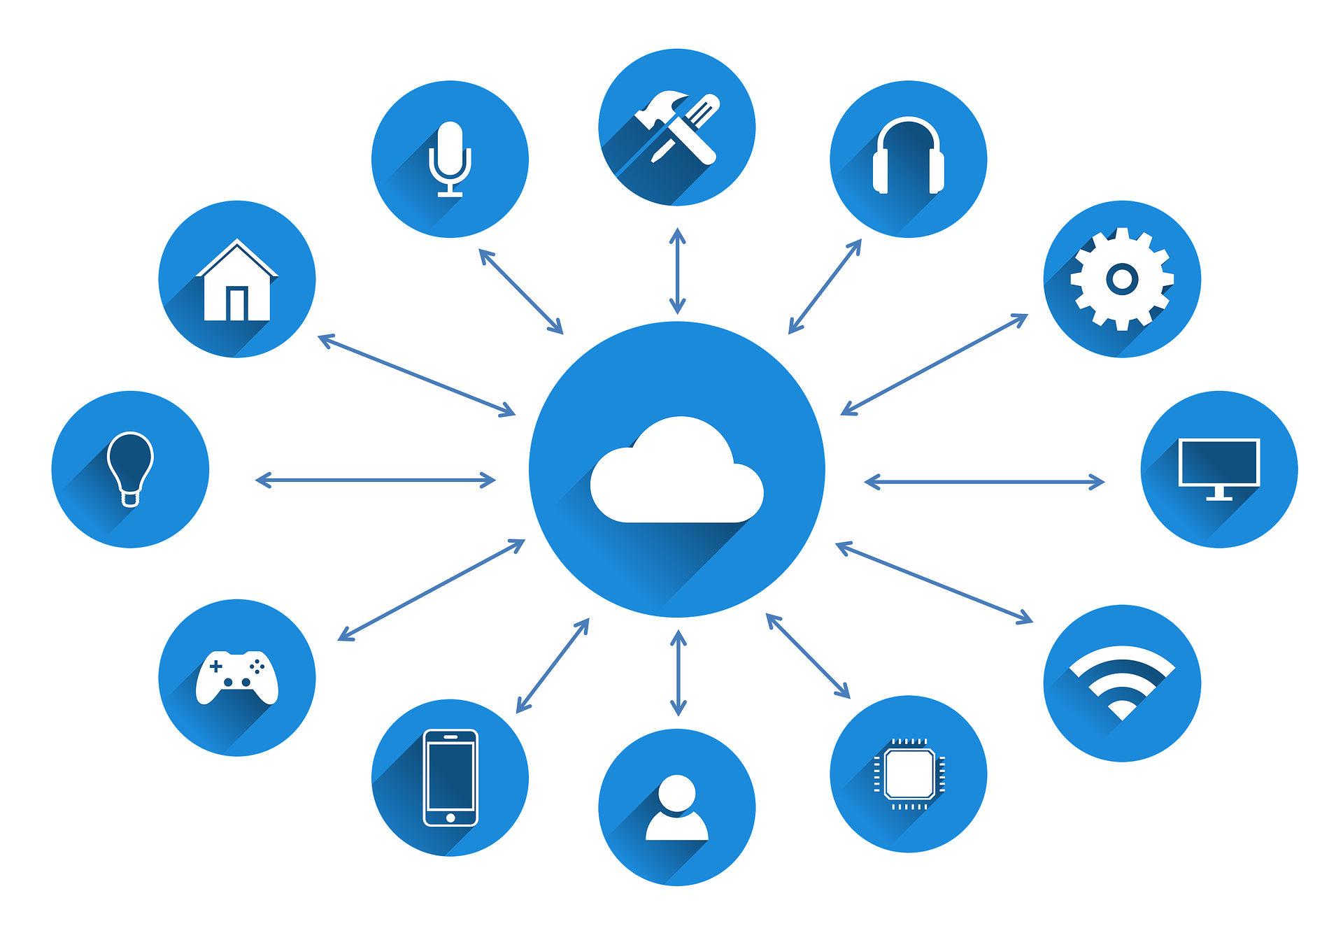
What Does It Mean?
According to Wikipedia- “The Internet of Things (IoT) is the network of physical devices, vehicles, home appliances and other items embedded with electronics, software, sensors, actuators, and connectivity which enables these objects to connect and exchange data.”
Difference With Computers
While computers (and by extension smartphones) are general purpose machines able to run different kind of code and software, IoT devices are special purpose devices that contain only the necessary hardware and software to do one task or a set of related tasks.
IoT devices have another function separate from computing while a computers main work is to run code.

Slide 3
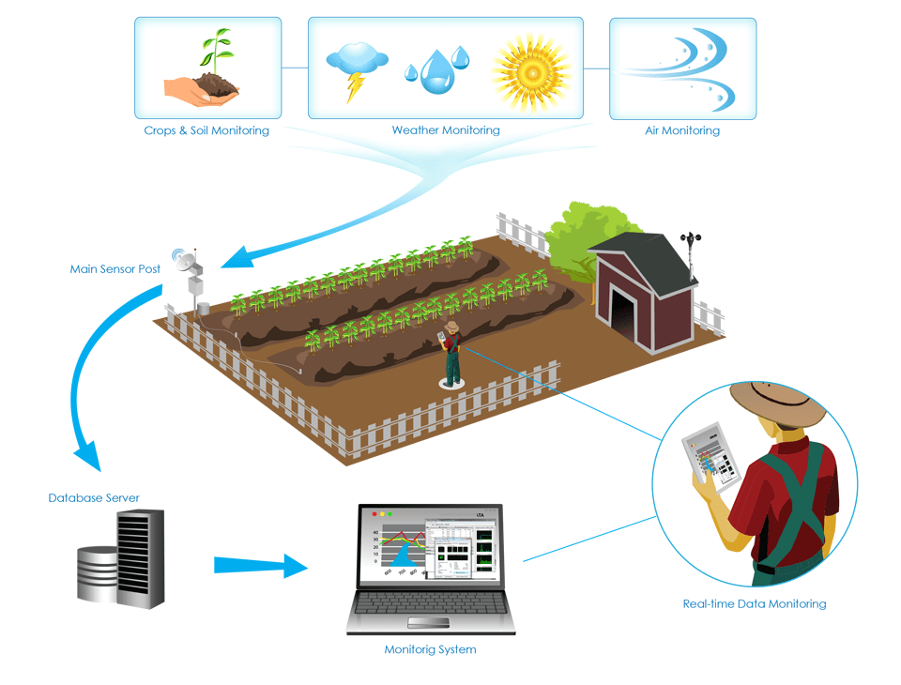
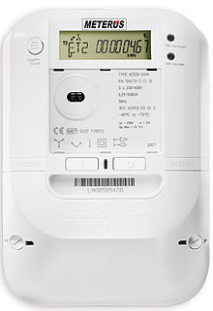
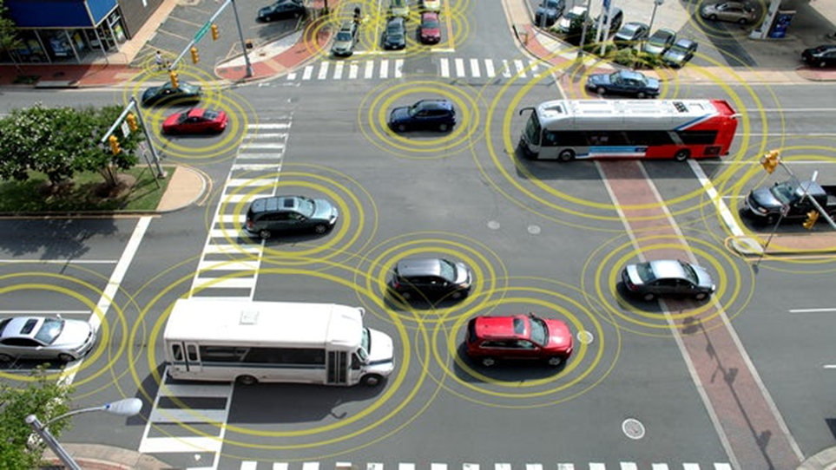
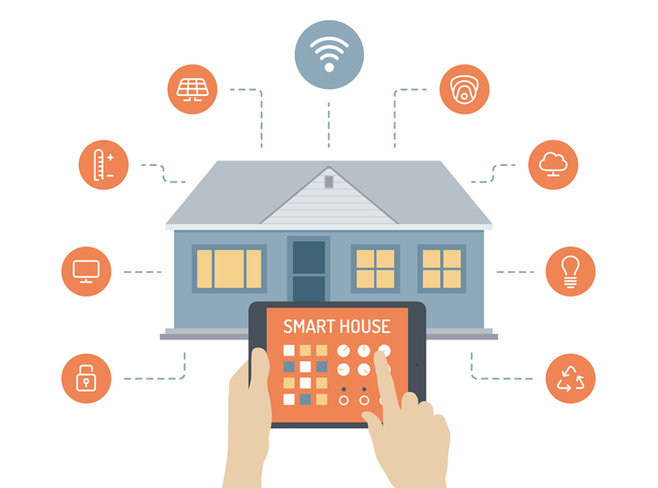
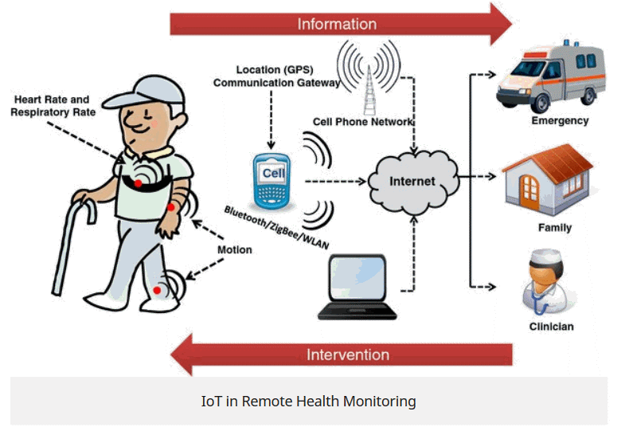
Use Cases
Agriculture
Predictive maintenance
Smart metering
Asset tracking
Connected vehicles
Healthcare
Homes
Smart parking:
Environment monitoring

Slide 4
Components of IoT

Slide 5
The Things- These are the end devices directly in contact with the physical environment. The thing is usually a sensor or actuator with a microcontroller as well as a communication module along with the electronic circuitry necessary for it to function.
The Network(Communication Technology)- This refers to the mode at which these ‘things’ communicate to the internet. Such technologies include Ethernet, Wi-Fi, GSM, LoRaWAN, Bluetooth etc.
The Internet/The Cloud- The cloud basically refers to computing resources that can be accessed over the internet. A lot of things happen in the cloud. Data is stored, cleaned, analysed. This is where the back-end services run. The back-end applications can do virtually anything you desire them to do, from controlling the IoT devices to machine learning.
The User End Devices/Dashboards - Users may need a platform to display information collected (and analytics) and a way to control their devices. This can either through a web interface or through a mobile phone app (Android or iOS).

Slide 6
IoT is Here to Stay, Pay Attention
IoT is everywhere, its use cases are limited only by our imagination. It basically consists of interconnected devices or ‘things’ that can send and receive data through the internet. It finds application in almost all industries known to man. One of the key features of IoT is that it is customized towards a specific use as per the particular need. The application of IoT technology can only continue to grow. In fact, It is estimated that by 2020 there will be a total of 50 billion connected devices and $267B will be spent on IoT technologies, products and services [1] [2]. It is then no wonder then that the likes of Amazon, IBM, GE, Cisco, Google, and Microsoft are investing big on IoT. So pay attention, the Internet of Things is not just hype, it is the real deal and it is here to change your life!

Slide 7
Thank You

